Slide 1
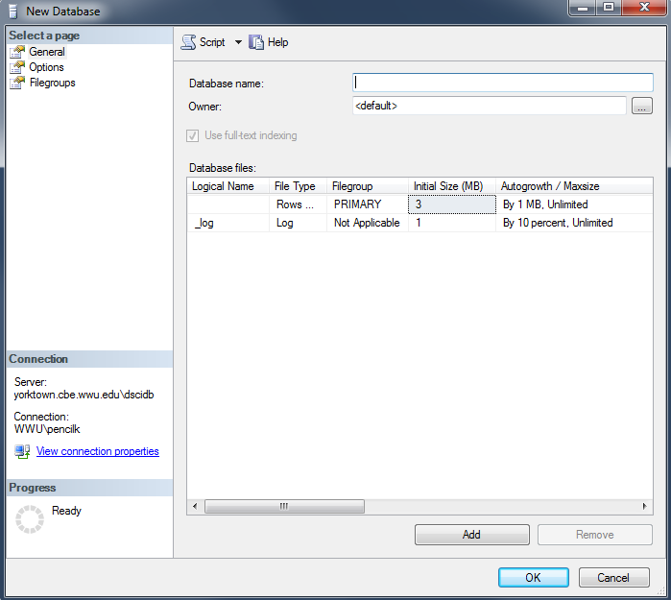
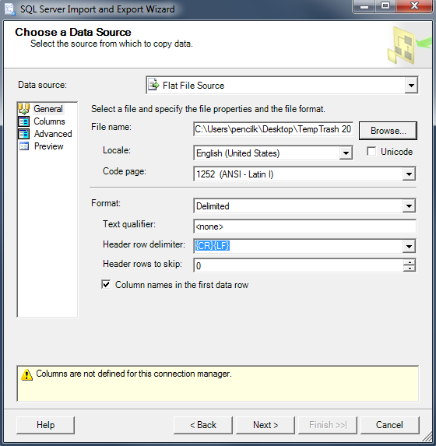
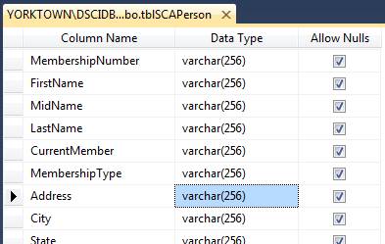
The Sister Cities Database
Development Project
The step described in this set of slides are marked here in red.
Create a database.
Prepare data for importing
Import data; simultaneously … creating the new table (LARGE STRINGS & INTEGERS)
Modify the table design as needed
1. New Database Wizard →
2. Original Data →
2. Prepped Data →
3. Import Wizard →
4: “Design” Window →
This presentation was prepared by Professor Steve Ross and modified by Kraig, with the advice of other MIS Faculty, for use in MIS Classes at Western Washington University. Please contact Dr. Ross for permission to use in other settings..

Slide 2
Introductory Slides
See “ImportingData - Overview and Preparation of the Database” for an overview, for creating a database and for basic preparation steps.
These slides show you how to simultaneously create the table and import the data when the data contains data in large strings.
Use the standalone Import and Export Data Tool
The difference between the two methods lies in the way to start. See the next two slides for the differences

Slide 3
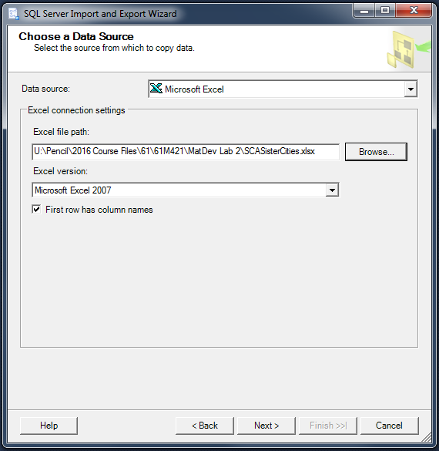
Standalone Import and Export Data Tool
In the Search box on the left of the taskbar of your computer, type SQL Server 2019 Import and Export Data (64 bit), if it shows in the available list, it means it has been installed (Some computers may have the 32-bit version, but we need the 64-bit version, not the 32-bit version). Otherwise, click for the instructions to install it. After it is installed,
From the Windows Program Menu, find and start
SQL Server 2019 Import and Export Data (64 bit)
Click Next on the Welcome window
Choose the Data Source Microsoft Excel) and browse to locate the file →
Note these settings (Excel version can be 2007 or later)

Slide 4
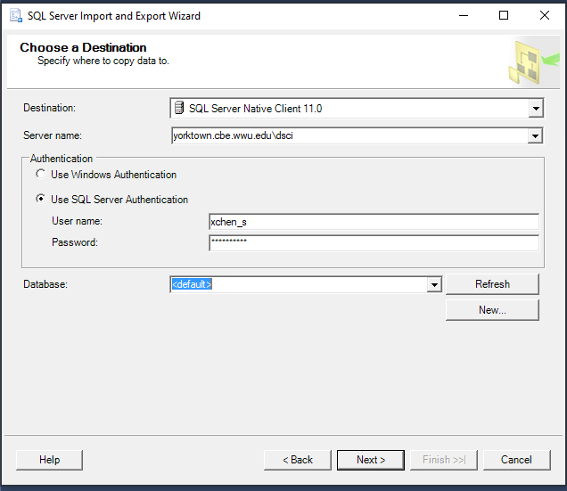
Destination
On the Choose a Destination window, choose Destination and type Server name as shown in the image. Then choose Use SQL Server Authentication and enter your SQL Server username and password.
Choose your database in the dropdown menu for Database
Click Next until you reach the window with “Sister Cities$” (illustrated on the next slide)

Slide 5
Note: in this example
“tblCity” is the entire Excel workbook.
“Sister Cities$” refers to a tab in the workbook.
Check “Sister Cities$” as shown.
Rename Destination to
Click Edit Mappings
Note that you can
name the new table below, or …
rename it after importation is complete.
[dbo].[tblSisterCity]

Slide 6
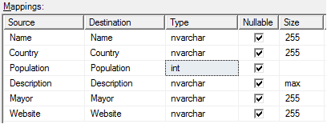
Under “Edit Mappings”, choose…
int as the data type for Population
nvarchar with size max for Description
Click OK to close Edit Mappings.
Click to the last window, then Finish

Slide 7
Continue through the import wizard until you reach the last window.
Note: along the way you may encounter the yellow warning symbol that you see above. Ignore it … and keep going to the last window)

Slide 8
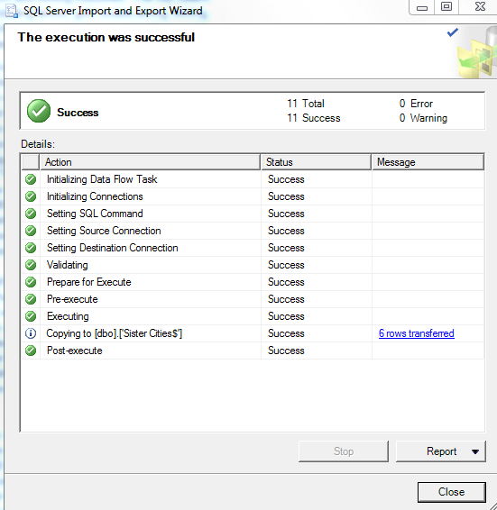
Click the Finish button.
The importation should complete without problem.
Close the wizard.
The new table in your database will be named either Sister Cities$ or tblSisterCity.
If necessary, remove any spaces or special character symbols, e.g. $ or quotation marks..

Slide 9
Verify the Import Results
Inspect the table (right-click table name, choose Select Top 1000 Rows)
Refresh “Tables”
Data in expected columns: verify
Numeric data format: ensure no loss
Character data: check for truncation (the Description of Punta Arenas is 193 words long).

